Slide 1

MINI PROJECT - E3-SEM2 2025 - 2026
Team Members (3C) :
KOTTI SATYANARAYANA S210052
Guide : Mrs. Musidi Roopa _{M.Tech}
Assistant Professor
Dept of Computer Science Engineering
PASILA PRUDHVI S210503
PEDDINTI DINESH KARTHIK O210572
VAJJA KIRAN S210019
MUDU JAHNAVI S211005

Slide 2
Table of Content:
Abstract
Introduction
Existing system
Problem Statement
Proposed system
Objective
Technologies Used
System Architecture
Methodology
Features
Advantages
Limitations
Future Enhancements
Results & Output
Conclusion

Slide 3
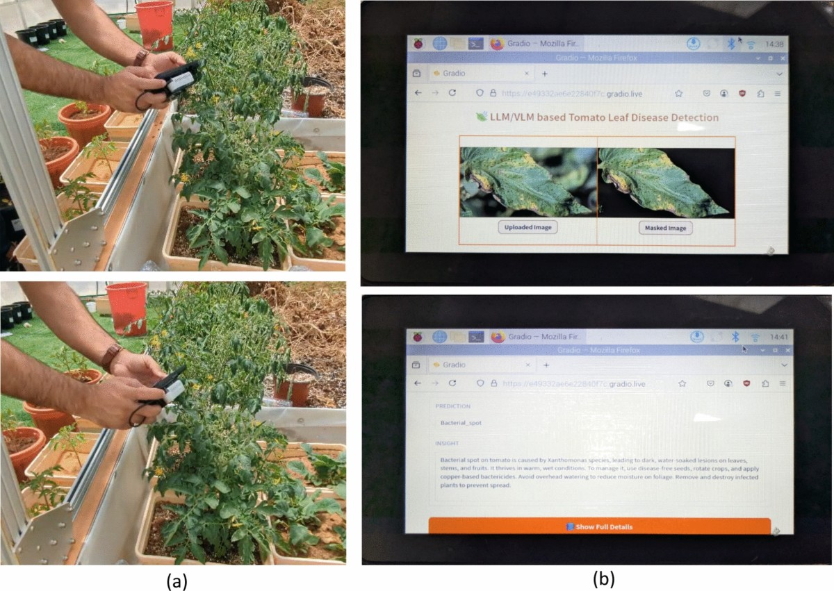
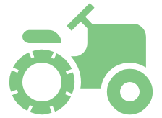

AI-Based Crop Disease
Detection System
Deep Learning Solution for Real-Time Crop Health Monitoring
95%+
<120ms
16
3
Accuracy
Inference Time
Disease Classes
Major Crops

Slide 4



Abstract
MobileNetV2
AI-Based Crop Disease Detection System is a web application helping farmers identify plant diseases using deep learning. It uses CNN with MobileNetV2 (TensorFlow/Keras) for disease classification from leaf images.
Lightweight transfer learning model
13.8 MB
Smart Diagnosis
Flask backend processes images, while React.js frontend provides interactive interface for uploading and displaying results with confidence scores. Trained on PlantVillage dataset, this user-friendly platform enables early detection, reduces crop loss, and supports better agricultural decision-making for farmers, students, and researchers.
Instant treatment recommendations
Cost-Effective
Replaces expensive expert consultations

Slide 5





Introduction
Background
Challenge
Agriculture is fundamental to global food security
Crop diseases cause 20-40% annual yield losses globally
Employs millions worldwide
Massive economic impact
Current Problem
Solution Approach
Manual detection requires expert agronomists
Leverage AI and deep learning for real-time disease identification
Costly
Slow
Not Scalable
Accessible & affordable for all farmers

Slide 6















Existing Systems
Traditional Methods
AI-Based Approaches
Manual Visual Inspection
Traditional ML (SVM, Random Forests)
Time-consuming
Requires expertise
Error-prone
Moderate performance
70-85%
Laboratory-Based Diagnosis
Deep Learning (ResNet, VGG, Inception)
Expensive
Slow (days-weeks)
Not practical
High accuracy
95%+
Heavy models
Rule-Based Decision Systems
Transfer Learning
Simple decision trees
60-70% Accuracy
Best balance of speed & accuracy

Slide 7






Problem Statement
Accessibility
Cost
Most farmers lack access to expert pathologists
Expert consultation expensive, commercial solutions unaffordable
Specific Challenges
No real-time disease detection at field level
Speed
Accuracy
Delayed diagnosis leads to rapid disease spread
Manual diagnosis takes time, delays crucial early intervention
Similar disease symptoms lead to misidentification
Resource-limited regions have no expertise
Current systems require internet connectivity
Generic treatment recommendations
Scalability
Manual inspection cannot cover large agricultural areas efficiently

Slide 8



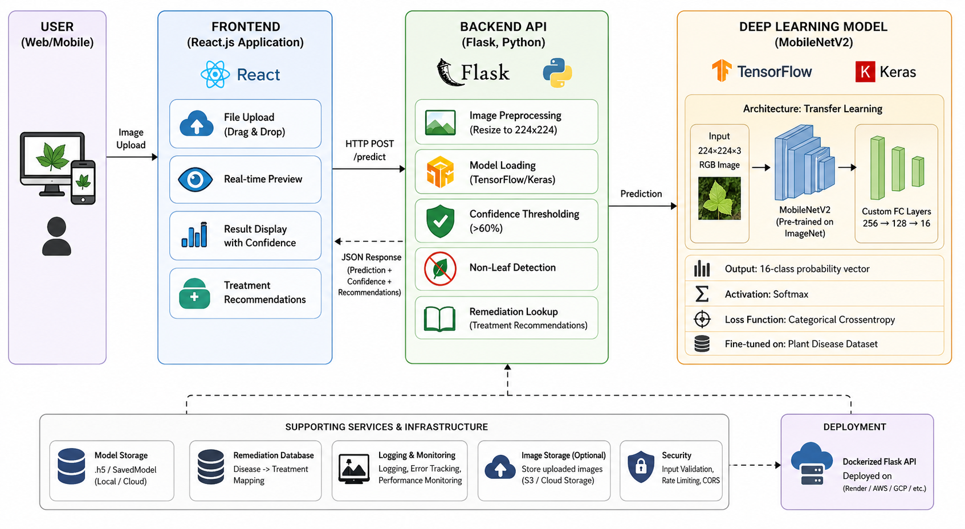



Proposed System
System Overview
Data Flow
Complete AI-powered disease detection platform
Deep Learning Model
MobileNetV2 for accurate classification
Backend API
Flask server for real-time predictions
Frontend Application
React web interface with intuitive UI
Remediation Database
Treatment advice for each disease

Slide 9












Objectives
Primary Objectives
Secondary Objectives
95%+ accuracy on 16 disease classes
Confidence thresholding to reduce false positives
<120ms real-time prediction system
Handle edge cases (non-leaves, low-quality photos)
User-friendly web interface
Support multiple crops in single platform
Actionable advice with treatment recommendations
Enable mobile and desktop access
Free & accessible solution for all farmers
Minimal model size (<15MB) for easy deployment

Slide 10









Technologies Used
Backend Stack
Frontend Stack
Model Architecture
Flask 2.x
React 19.x
MobileNetV2
Python web framework
UI framework
ImageNet pre-trained
TensorFlow 2.x + Keras
CSS3
224×224×3 RGB
Deep learning framework
Flexbox, Grid, Animations
Input dimensions
Python 3.8+
React Hooks
16-Class Output
Core programming language
useState, useRef
Softmax classification
PIL / NumPy / SciPy
Fetch API
Adam Optimizer
Image & data processing
HTTP client
Adaptive learning rate
Source
Data Split
Augmentation
Class Balancing
Dataset & Training
PlantVillage Dataset
70% Train / 20% Val / 10% Test
Rotation, Zoom, Shift, Flip
Weighted Loss Function

Slide 11
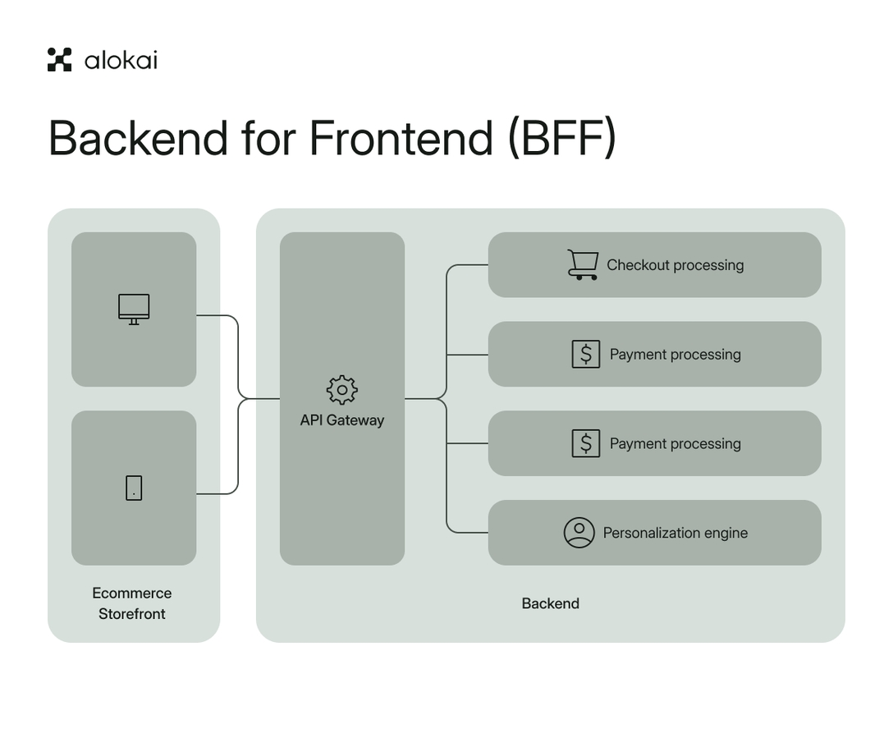







System Architecture
Architecture Flow
User Interface
Flask Backend
MobileNetV2
• React Frontend
• Image Preprocessing
• 16-Class Output
• Drag & Drop Upload
• Model Inference
• 13.8 MB Model
• Real-time Preview
• Transfer Learning
• Confidence Check
Frontend Input
Backend Processing
• JPEG, PNG, WebP formats
• Resize to 224×224
• File validation & preview
• Normalize pixel values
• Results & recommendations
• JSON response output
Supported Crops
Detection Classes
Tomato • Potato • Pepper
16 Disease Categories

Slide 12









Methodology
Data Preparation
Model Development
Model Evaluation
1
2
3
• PlantVillage dataset (54k images)
• MobileNetV2 transfer learning
• 95%+ accuracy on test set
• 70/20/10 train/val/test split
• Custom dense layers (256→128→16)
• <120ms inference time
• Augmentation: rotation, zoom, shift, flip
• Adam optimizer, categorical loss
• 60% confidence threshold
Backend Development
Frontend Development
Integration & Testing
4
5
6
• Flask API with /predict endpoint
• React component with hooks
• End-to-end testing
• Image upload handling
• Drag-and-drop file upload
• Edge case handling
• Remediation database integration
• Real-time image preview
• Performance optimization
Training Configuration
Performance Metrics
Quality Assurance
Batch Size: 32 • Epochs: 20 • Early Stopping
Accuracy: 95%+ • Latency: <150ms
Confidence Threshold: 60%

Slide 13











Features
Core Features
Additional Features
Real-Time Detection
Multi-Crop Support
Batch Processing
Get prediction in <200ms
Tomato, Potato, Pepper
Upload multiple images
Confidence Scoring
Treatment Advice
Export Results
PDF & JSON format
Color-coded visual indicators
14 diseases documented
Disease Tracking
User-Friendly UI
Error Handling
Monitor disease trends
Drag-and-drop upload
Non-leaf & low-quality detection
Offline Mode
Deploy locally for offline use
16 Disease Classes: Tomato (9 diseases + healthy), Potato (3 diseases + healthy), Pepper (2 diseases + healthy)
Mobile Responsive
Works on all devices
Performance
Detection Speed
<200ms

Slide 14







Advantages
Technical Advantages
Practical Advantages
Lightweight Model
Cost-Effective
Only 13.8 MB vs ResNet50's 100MB+
Free, open-source, <$10/month hosting
High Accuracy
Accessible
95%+ on test set with transfer learning
No technical expertise, mobile-friendly
Efficient Architecture
User Experience
Depthwise-separable convolutions for edge devices
Instant feedback <1 second, intuitive interface
Fast Inference
Reliable
<120ms per image, no GPU required
Robust error handling, confidence thresholding

Slide 15








Limitations
Technical Limitations
Practical Limitations
Environmental Sensitivity
Limited Crop Coverage
Accuracy varies: 85-97% depending on lighting conditions
Only 3 crops (Tomato, Potato, Pepper) with 14 diseases
Image Requirements
Model Constraints
Trained on controlled dataset, struggles with multiple infections
Requires clear, close-up leaf photos; blurry images rejected
Deployment Constraints
Early Disease Stage
Requires backend server, internet needed for web version
May miss >10% of early-stage infections

Slide 16













Future Enhancements
Short-Term
Medium-Term
Long-Term
1-3 months
3-12 months
12+ months
Mobile Application
Model Expansion
IoT Integration
React Native/Flutter with offline inference
10+ crops, 50+ diseases
Weather stations & smart irrigation
Database Integration
Advanced Detection
Precision Agriculture
Track disease trends and field reporting
Multi-disease & severity assessment
Drone monitoring & disease forecasting
Batch Processing
User Management
Enterprise Solutions
Multiple images & CSV export
Farmer profiles & historical records
Government surveillance & insurance
Enhanced Remediation
AI Improvements
Knowledge Platform
Regional treatment & supplier links
Ensemble models & explainability
Farmer community & expert network

Slide 17









Results & Output
Model Performance
Real-World Validation
Clear Image Accuracy
Disease Detection
97%+
Fungal & Viral
Test Accuracy
Inference Time
95-98%
<120ms
Healthy Recognition
Non-Leaf Filtering
99%+
Effective
Sample Output Example
Model Size
Disease Classes
13.8 MB
16
Status: success
Plant: Tomato
Disease: Early Blight
Performance by Crop
Confidence: 95.34%
Remedy: Apply fungicides (chlorothalonil/mancozeb). Remove lower infected leaves.
Tomato
96-98%
Potato
94-97%
Pepper
95-99%

Slide 18
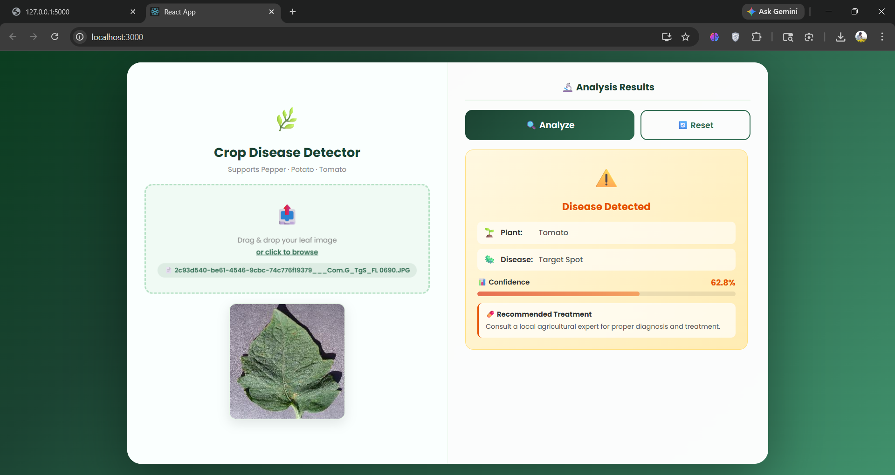
Output in Website:

Slide 19










Conclusion
Key Achievements
Impact & Vision
High Accuracy Model
95%+ accuracy on 16-class disease classification
For Farmers
For Agriculture
Affordable instant diagnosis
Scalable disease management
Fast & Lightweight
<120ms inference, 13.8MB model size
User-Friendly Interface
For Developing Regions
For Economy
Intuitive web interface requiring no technical expertise
Addresses expertise gap
Prevents billions in losses
Comprehensive Database
Transformative Potential
Integrated remediation database with 14 diseases
This system democratizes agricultural disease diagnosis, empowering farmers worldwide to make informed decisions about crop management without expensive expert consultation. With scalability to additional crops and integration with IoT/precision agriculture technologies, the system has potential to revolutionize farming practices globally.
Production-Ready System
Flask API with robust error handling, offline-capable

